Slide 1
Design Patterns Decorator
Kamal Pashayev

Slide 2
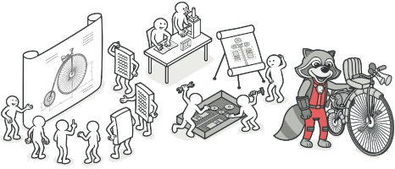
What is Design Pattern?
Design patterns are typical solutions to common problems in software design. Each pattern is like a blueprint that you can customize to solve a particular design problem in your code.

Slide 3
In addition, all patterns can be categorized by their intent, or purpose. This book covers three main groups of patterns:
Creational patterns - These patterns provide various object creation mechanisms, which increase flexibility and reuse of existing code.
Structural patterns - These patterns explain how to assemble objects and classes into larger structures while keeping these structures flexible and efficient.
Behavioral patterns - These patterns are concerned with algorithms and the assignment of responsibilities between objects.

Slide 4
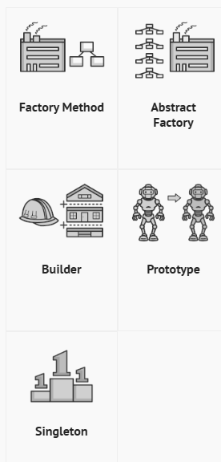
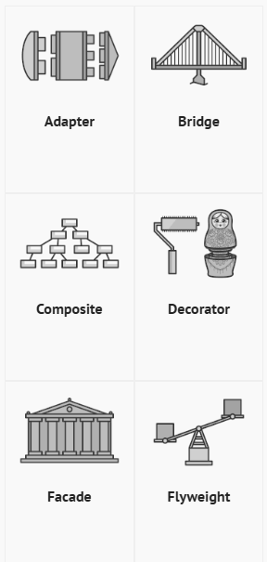
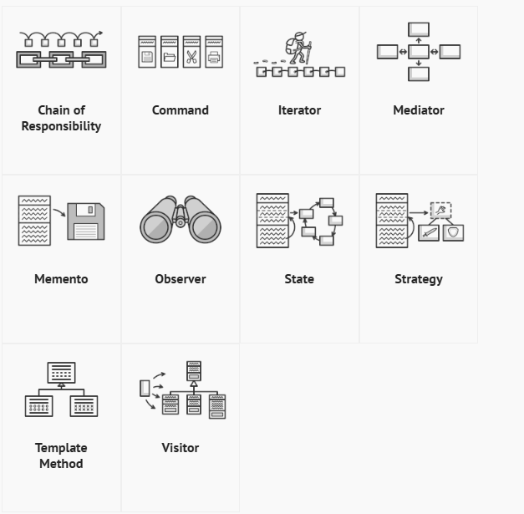

Slide 5
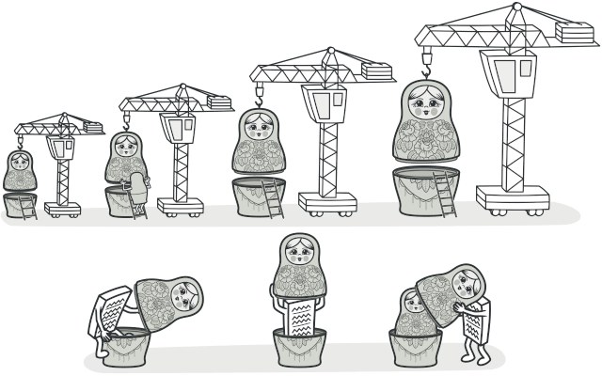
Decorator is a structural design pattern that lets you attach new behaviors to objects by placing these objects inside special wrapper objects that contain the behaviors.

Slide 6
Problem Statement
Imagine you are developing a software system for a car dealership that allows customers to configure and customize their vehicles online. The system supports various models of cars, and customers can add optional features or packages to enhance their chosen model. You decide to use the Decorator pattern to dynamically add these features to a base car model.

Slide 7
Thanks!

